Slide 1

Docker in deep learning
Mohammad navid afzali
Dr.rastgoo

Slide 2
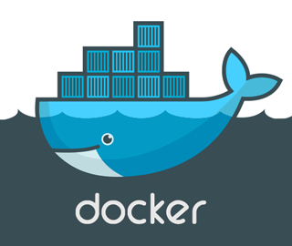
What is docker?
About docker and it’s benefits

Slide 3

Developing with Docker
Developing apps today requires so much more than writing code. Multiple languages, frameworks, architectures, and discontinuous interfaces between tools for each lifecycle stage creates enormous complexity. Docker simplifies and accelerates your workflow, while giving developers the freedom to innovate with their choice of tools, application stacks, and deployment environments for each project.

Slide 4



Docker
A brief history…
Process container (2006)
LXC (2008)
Start it work since 2013
Introduce commercial service in 2016
Using by Google , Microsoft , IBM , …
Improve build,develop and running apps!

Slide 5
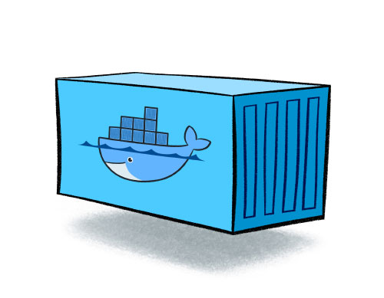
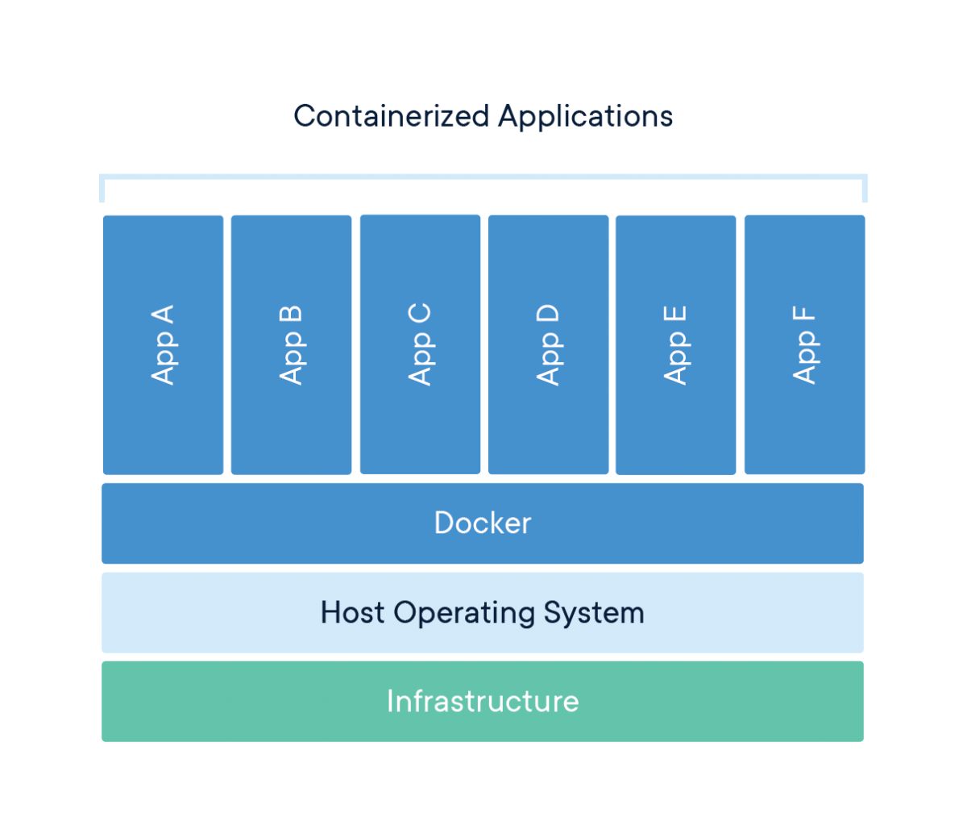
What is container?
A container is a standard unit of software that packages up code and all its dependencies so the application runs quickly and reliably from one computing environment to another.
Package Software into Standardized Units for Development, Shipment and Deployment

Slide 6
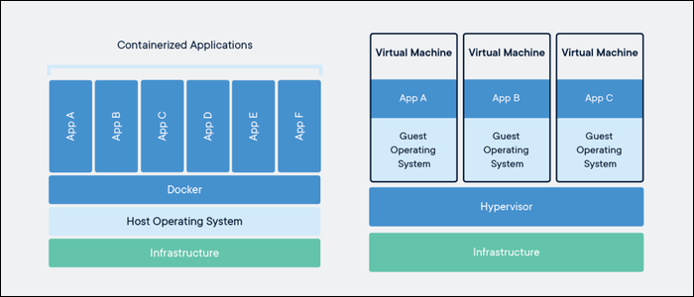
Difference between docker and Vm
In Docker, the containers share the host OS kernel but VM does not share it .
The application in Docker containers starts with no delay since the OS is already up and running.but in VM, It takes a much longer time than it takes for a container to run applications.
Docker containers can start up quickly and result in less boot-up time.but Virtual machines don’t start quickly and lead to poor performance.

Slide 7
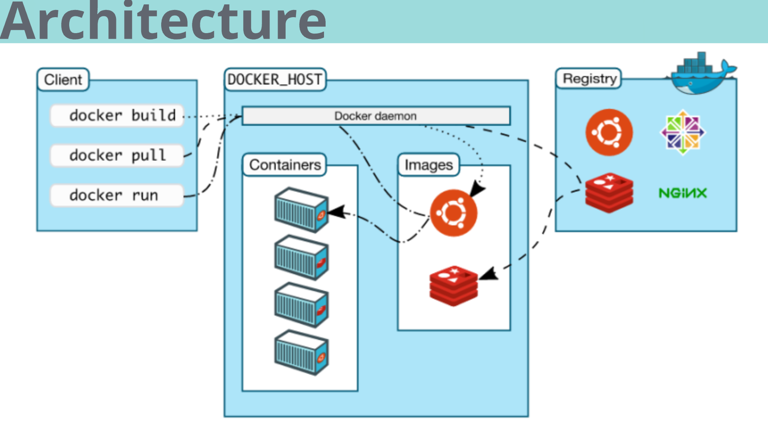
Architecture

Slide 8



Why using Docker?
Why should we use it?
Madularity and portable
More workspace with normal hardwares
Fast
Can use its image everywhere.
Code,test and deploy fastly and save time.
Less resources, more tasks.

Slide 9
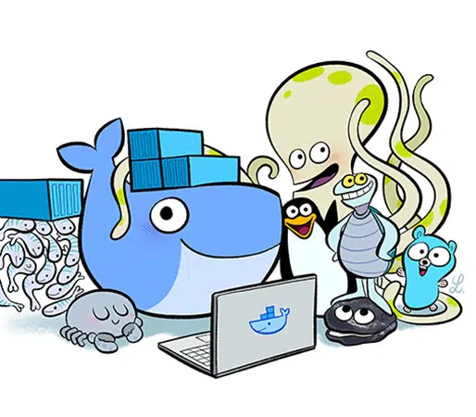
Advantages
Stability
Save storage space
The breadth and flexibility of the developer community
Can be used on Mac and Windows
Automation

Slide 10

Disadvantages
Lack of documentation
There are currently functional issues for the Mac
Problems occur in non-native environments

Slide 11
Docker popularity
Why it’s popular?
Work with containers.
Works in any hosts and environments.
More simple than VMs.
Good for one-time use.
Real-time runtime.

Slide 12


Docker components
Docker client
Docker deamon
Docker registry
Docker image
Docker container
Like An UI for docker
Send your request to docker deamon.
Build , run and distribute containers.
Storage for docker images.
Is a read-only template with instructions for creating a docker containers.
Is a runnable instance of an image…

Slide 13
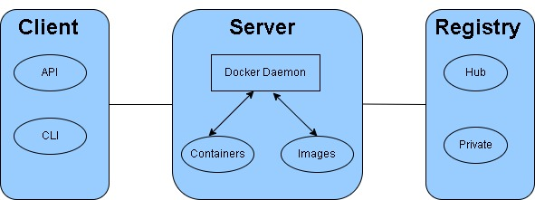
Docker client
The Docker client ( docker ) is the primary way that many Docker users interact with Docker.
The docker command uses the Docker API.

Slide 14
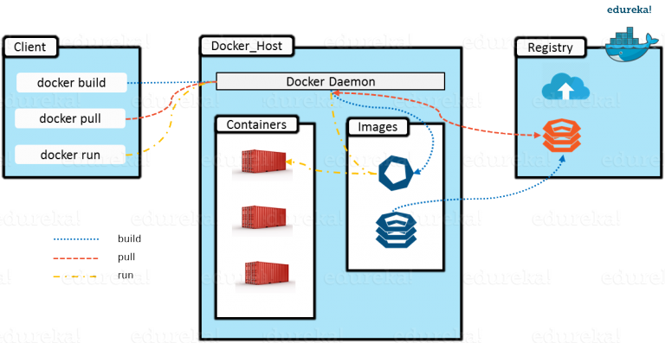
Docker daemon
A service that runs on our host operating system.

Slide 15
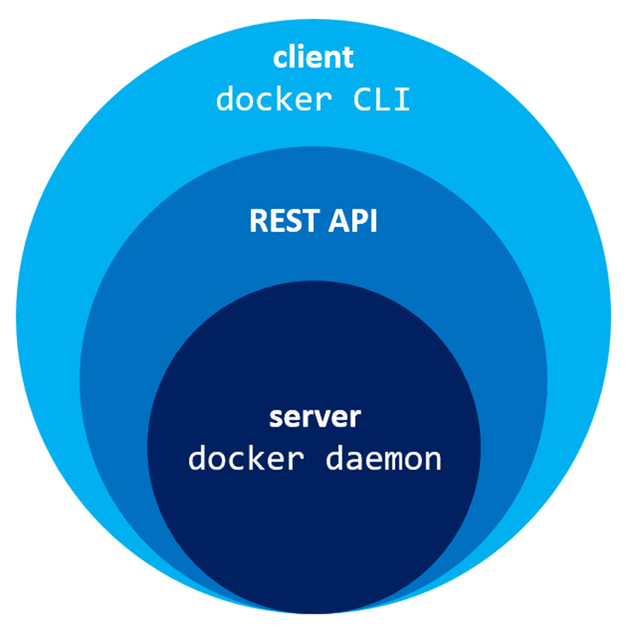
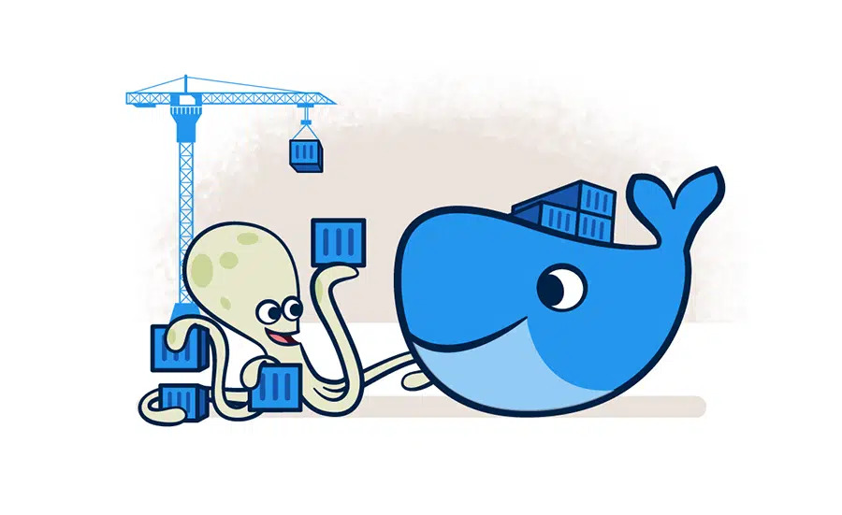

Slide 16

Docker registry & Docker hub
Docker registry is a storage for images . we have many registry. By default , docker user docker hub registry.
The world’s leading service for finding and sharing container images with your team and the Docker community.

Slide 17
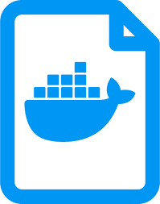
Docker images
A Docker image is a file used to execute code in a Docker container. Docker images act as a set of instructions to build a Docker container, like a template.

Slide 18
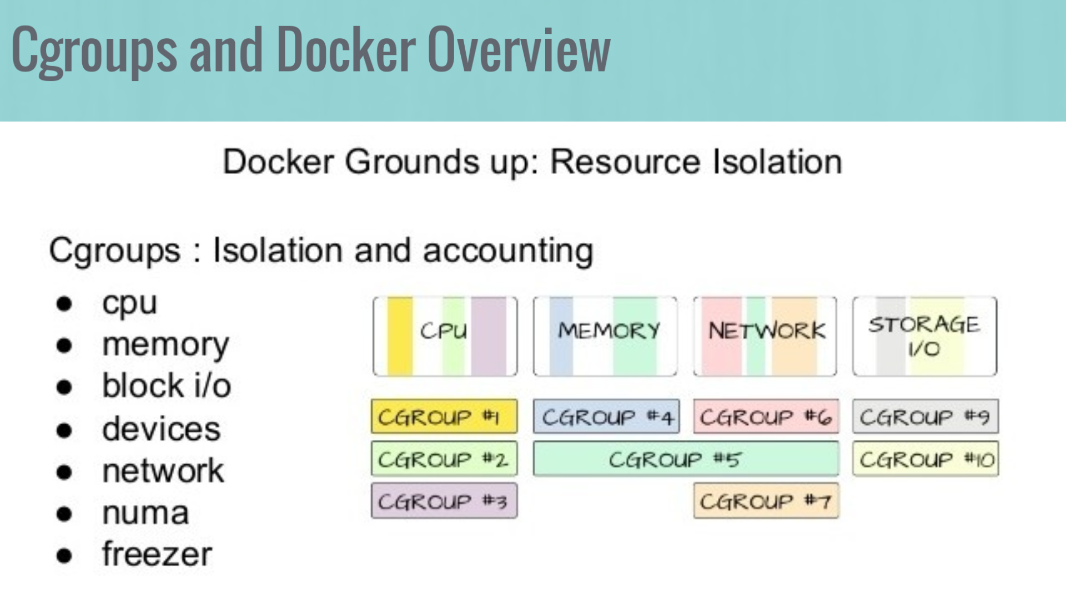
Cgroups

Slide 19
Docker commands
Most important docker commands

Slide 20
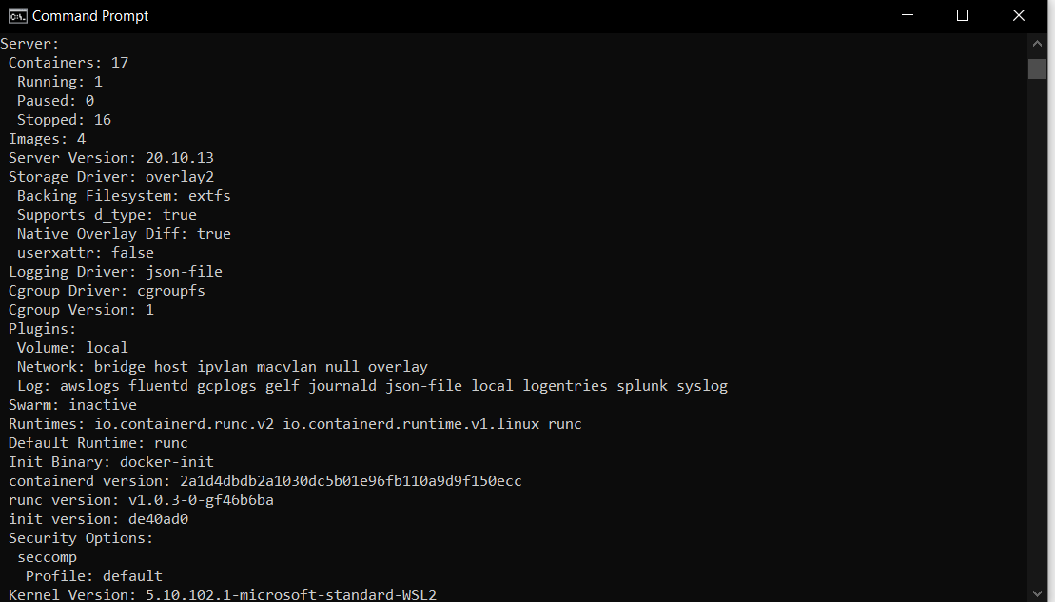
Docker info
General information about docker, containers, images, hardwares and so on.

Slide 21
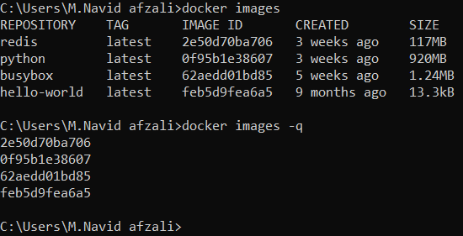
Docker images
List all images that available in our local system with their id’s , size, tag and time created.
Have many options like –q that list images by their id’s.

Slide 22
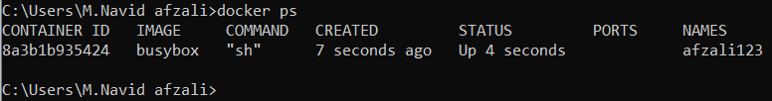
Docker ps
List all containers(running containers) on our local system . Explain that which image is run in container.
If you want to see all containers, you must use option –a.

Slide 23
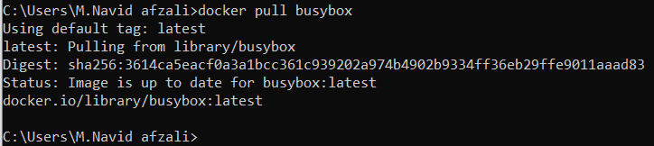
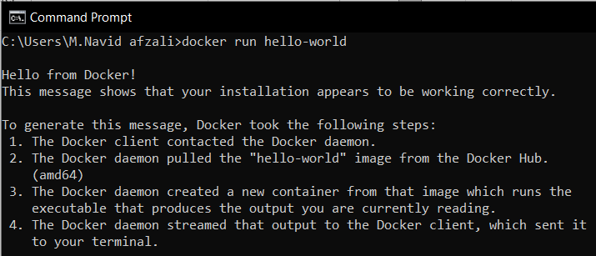
Docker pull & docker run
Docker pull: try to pull images from registry (docker hub by default) .
Docker run : at first search images in local . If the image is not available , then pull it from registry and then run it in container.

Slide 24
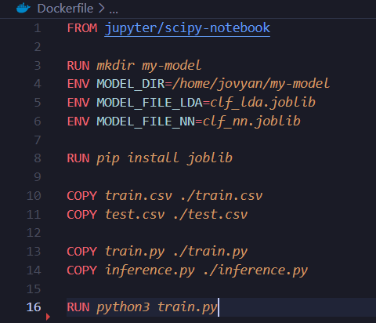
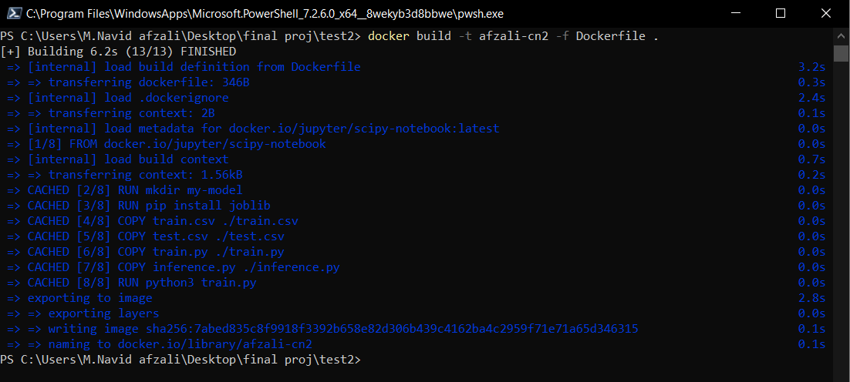
Docker build
Build images .
We can build our custom images by a file named “Dockerfile” . In docker file we write some manual how to build image.
Next slides we’ll build an image.

Slide 25
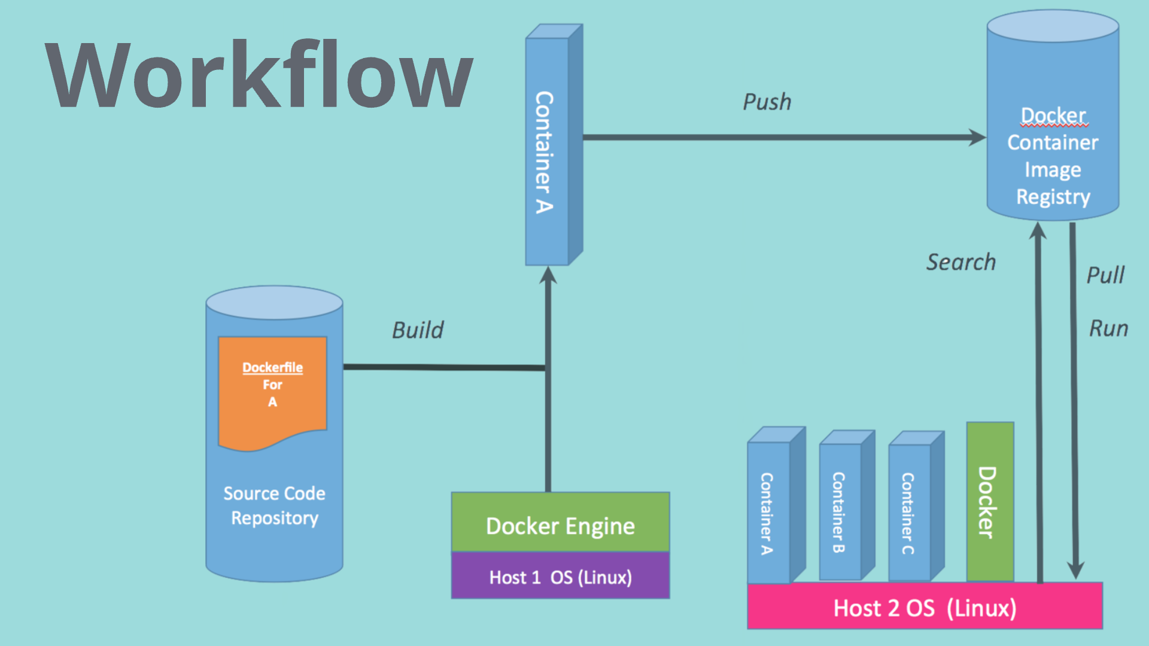

Slide 26

Docker and deep learning
Why use docker for our dl projects?

Slide 27

Deep learning
Deep learning (also known as deep structured learning) is part of a broader family of machine learning methods based on artificial neural networks with representation learning.
Deep learning is a machine learning technique that teaches computers to do what comes naturally to humans

Slide 28

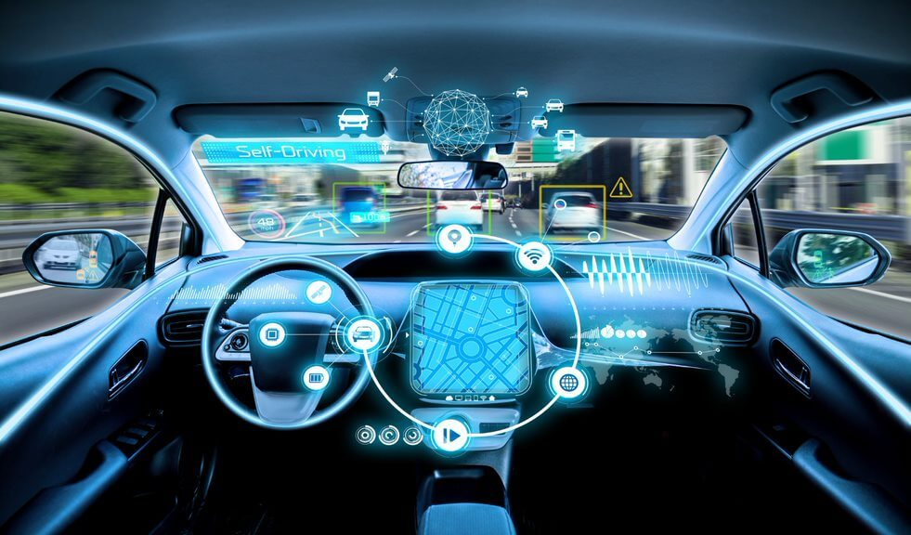

Deep learning applications
self-driving cars
Virtual assistants
Face recognition
Chat bots
Entertainment
…

Slide 29
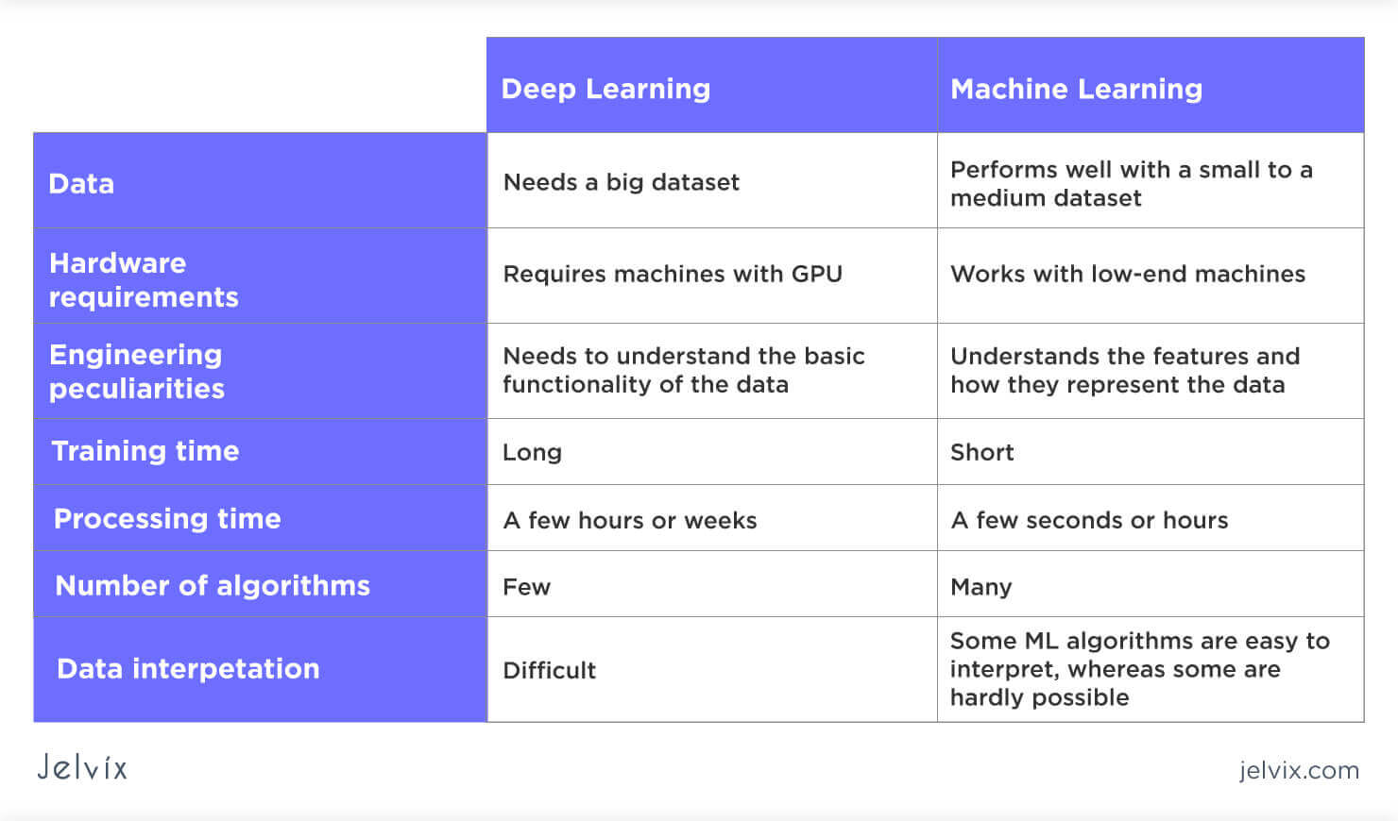
Difference between deep learning and machine learning

Slide 30



Docker and deep learning
Why should we use docker for our deep learning projects?
Many libraries & dependencies
Simple & fast
Use project everywhere
Will have trouble to manage them.
Easy to use , light and fast to deploy.
Even other hosts have different version of dependencies.

Slide 31
Build image for Dl project in docker
Build and run image for deep learning project.

Slide 32

How to build image?
A Dockerfile is a text document that contains all the commands a user could call on the command line to assemble an image.
Use dockerfile to start building image.

Slide 33
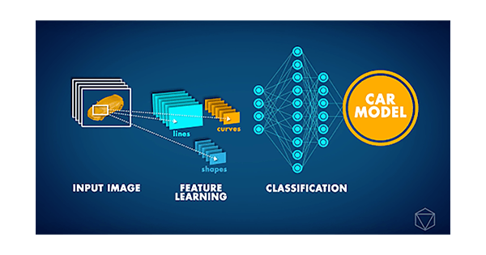
Sample project: CNN image classification
The Convolutional Neural Network (CNN or ConvNet) is a subtype of Neural Networks that is mainly used for applications in image and speech recognition. Its built-in convolutional layer reduces the high dimensionality of images without losing its information. That is why CNNs are especially suited for this use case.

Slide 34

CNN project with API
We're going to be building a RESTful API service for a TensorFlow CNN model that classifies food images.
After building the API service, I'll show you how to dockerize the application.

Slide 35
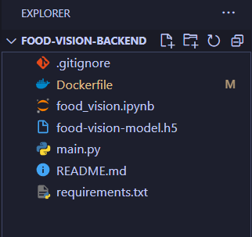
Step 1 : finish project in local
At first complete debug and run project in our localhost.
After that we’ll start to make dockerfile.

Slide 36
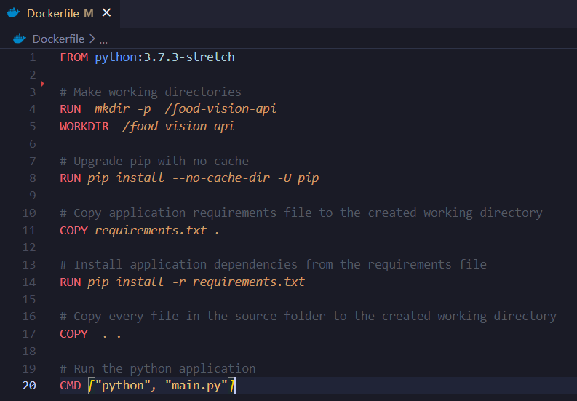
Step 2 : write Dockerfile
Write manuals in Dockerfile that how to build image.
[FROM];Use base image: A base image is the image that is used to create all of your container images.
[RUN];run commands in container.
[COPY]; copy files from local to container.
[CMD]; CMD is the command the container executes by default when you launch the built image.

Slide 37
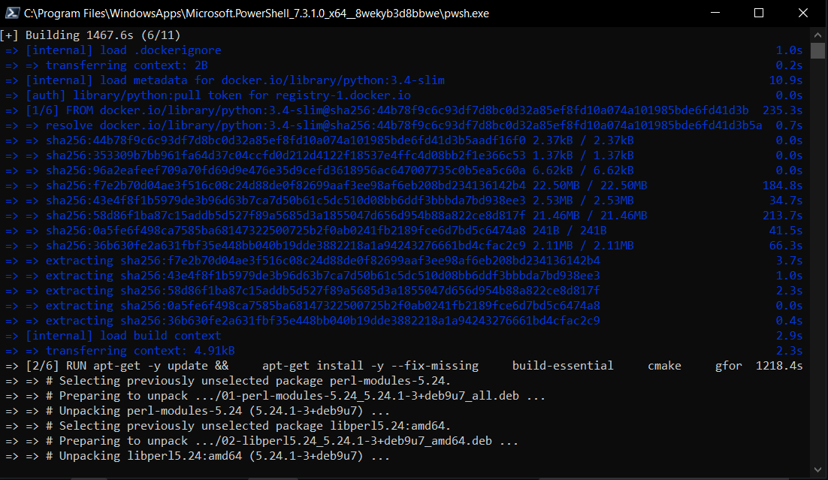
Step 3 : build image
Start to build image from written Dockerfile.
Use “docker build –t <image-name> .” to start building your image.

Slide 38
Step 4 : run image on container
Run image on a sample container.
Use “docker run –p 5000:5000 –d <image-name>
-d: run container in detached-mode(background)
-p: set port for container.
Output must be the id of container.

Slide 39
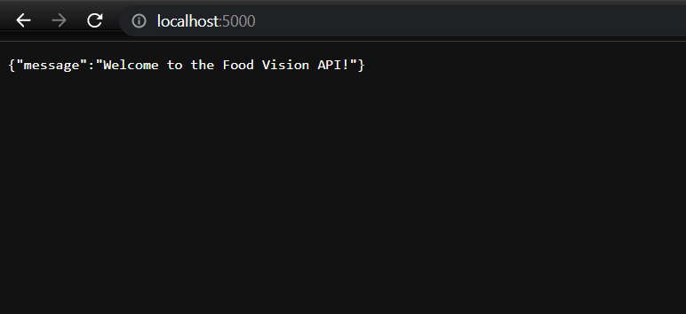
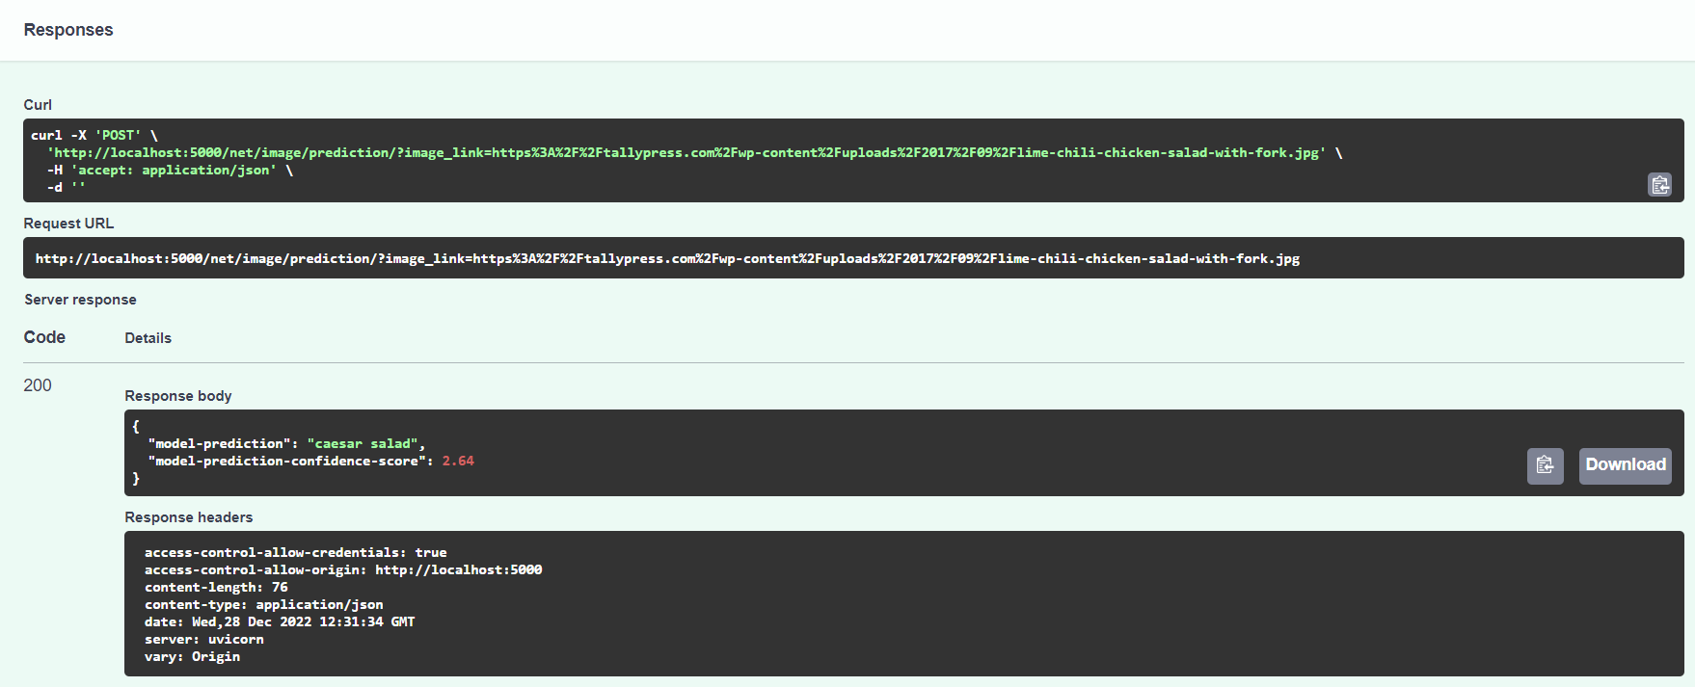
Step 5 : your app is ready!
Now go to https://localhost:5000 . You can use your app now.

Slide 40
Summary
This is how we use docker for our deep learning projects. Now we don’t have trouble such as “It works in my system, why it doesn’t work in yours?” . Docker manage all libraries and dependencies for us . Using containers is simple,fast and scalable.

Slide 41




Thank You
Mohammad navid afzali
9711126012
navid.afzali12@gmail.com
www.docker.com

